Slide 1
VIDEOGAME DESIGN

Slide 2
Action plan
Goals
Collect ideas for our game
Brainstorming
Points system
Winning/Defeat situation
Present some USE CASES
Drawings with real use situations
Design possible sketches for the user Interface
Map of screens/stages
Collect all the ideas to be presented later

Slide 3
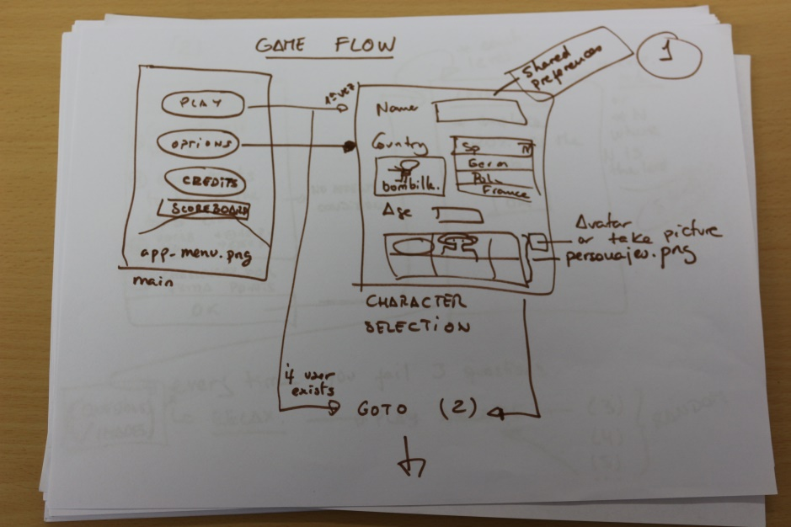
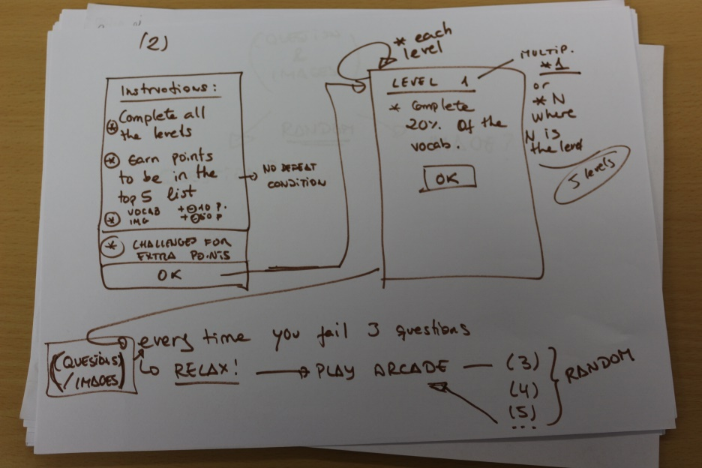
Videogame Flow decided
Here we have a few examples about how the videogame would be made.

Slide 4
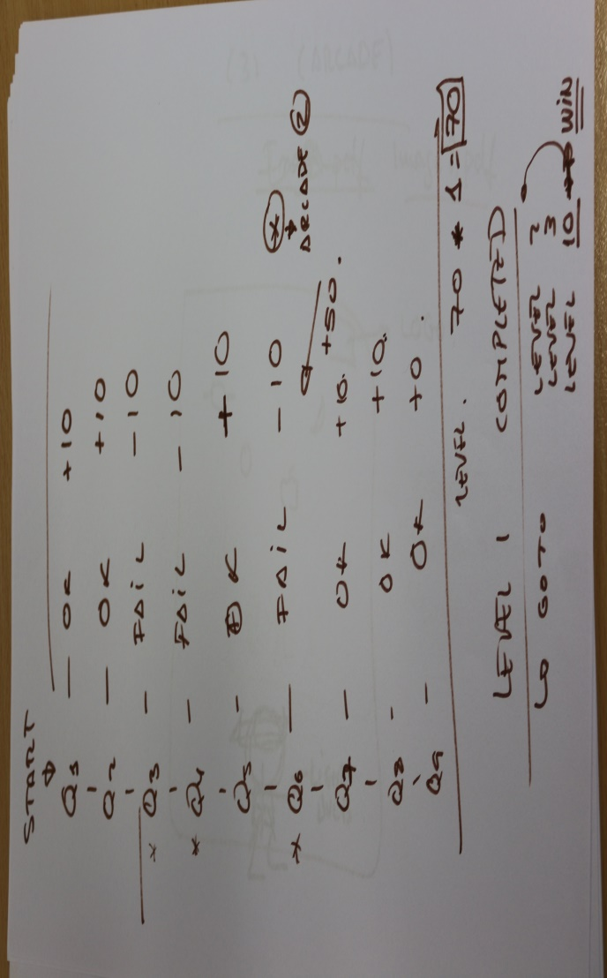
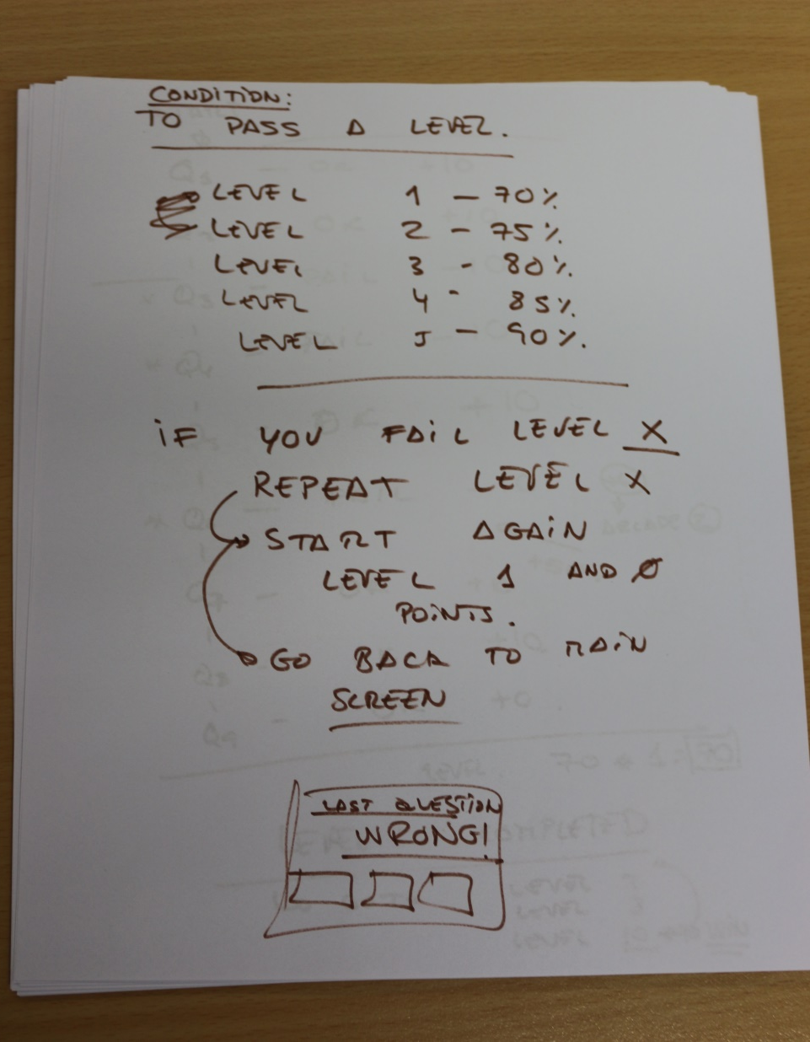
Logic

Slide 5
Vocabulary Data Base
All students from different countries must make a database with words and their translations to include into the videogame
To be sent to your teachers before February

Slide 6
Videogame development
The videogame will be developed in Spain by DAM students (Multiplatform Application Development).
We will divide the project in different groups:
Graphics
Logic
Arcade

Slide 7
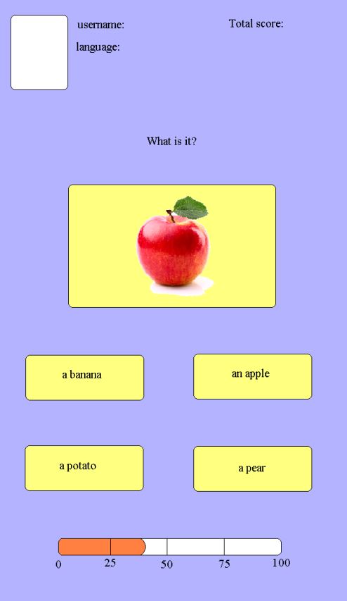
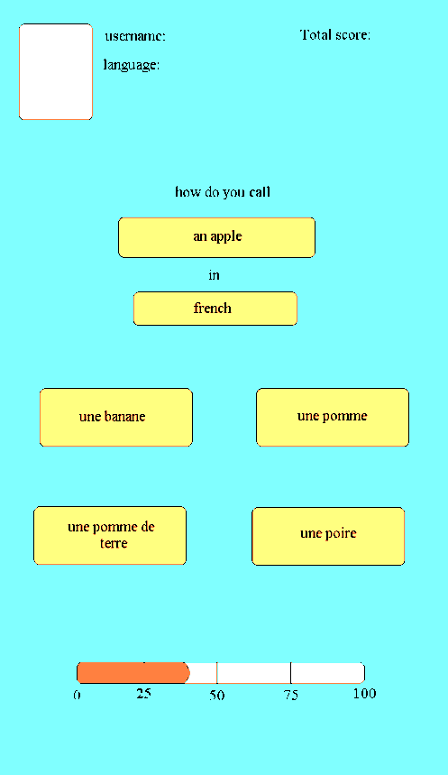
Videogame Art
All the graphic design (images) which will be used in questionnaires were designed by French girls on the workshop group for the videogame
Here we have a few examples of the challenges

Slide 8
Workshops
Here in Germany we have designed how the videogame will look
It was useful to put in common all the ideas we have.
That is the way that everybody can participate in the project

Slide 9
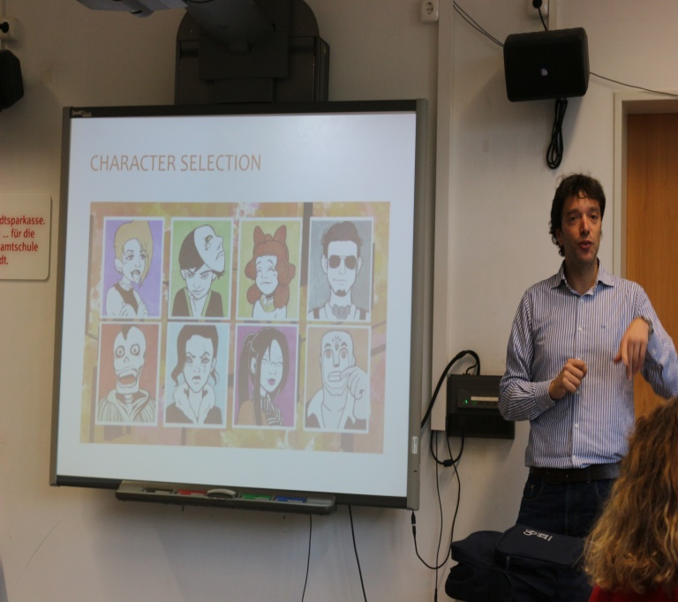
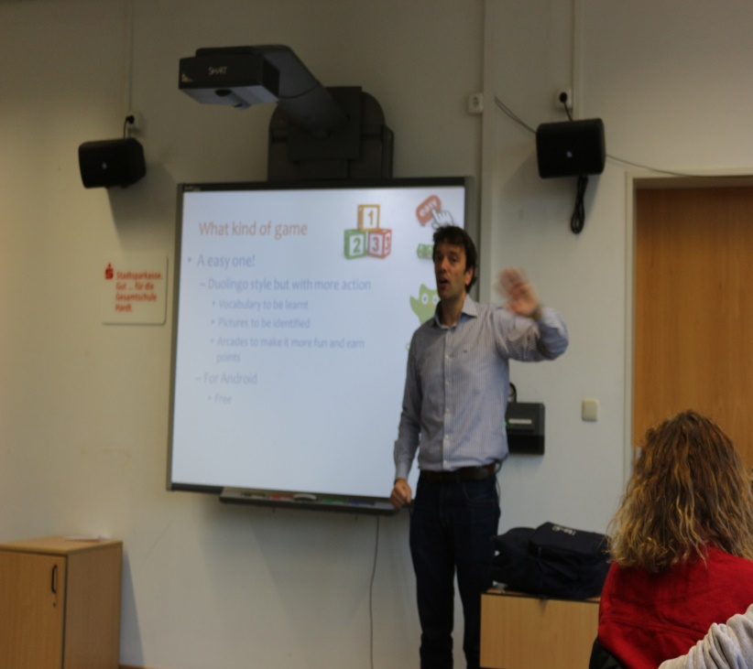
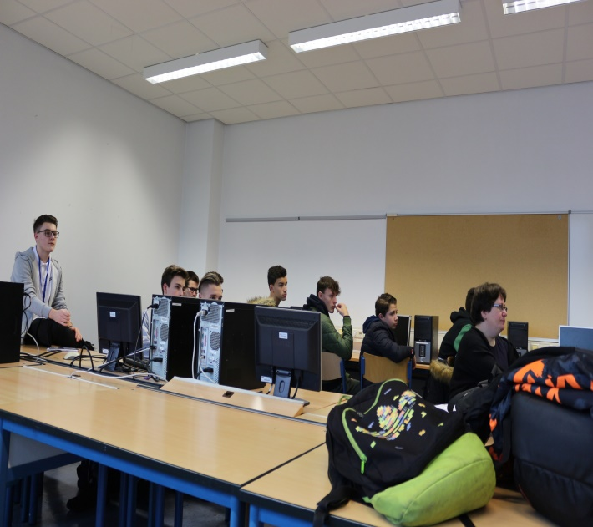
Workshops
Preparations

Slide 10
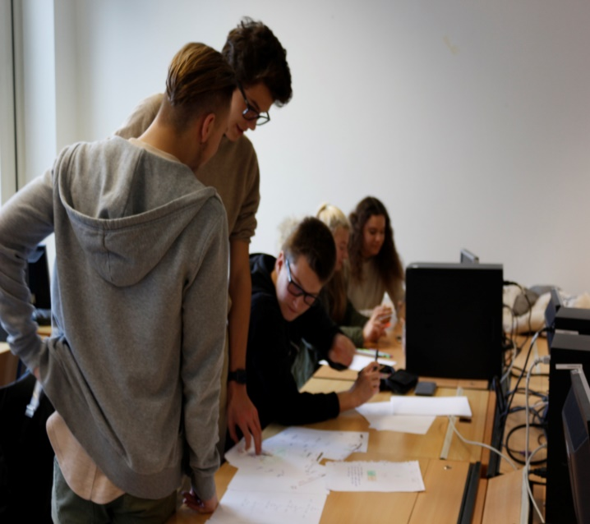
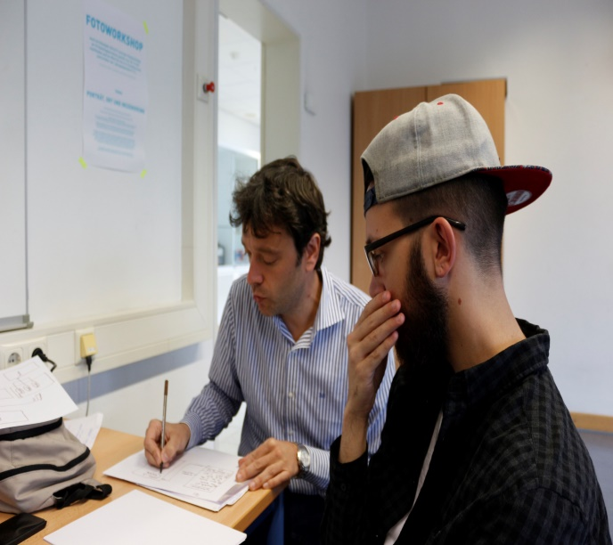
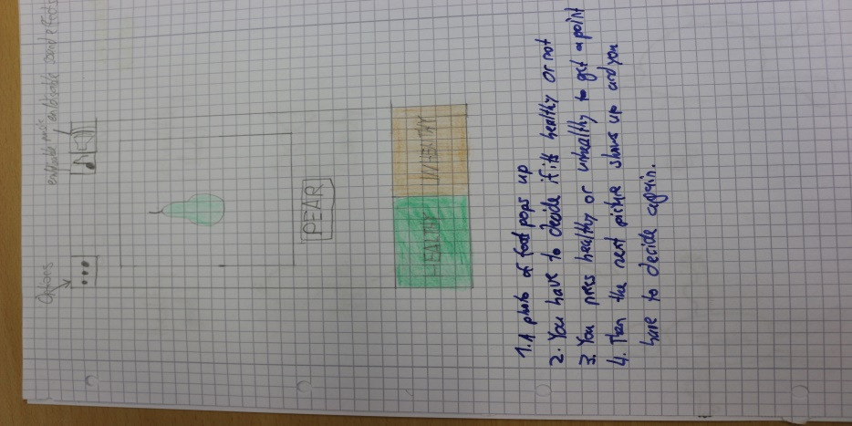
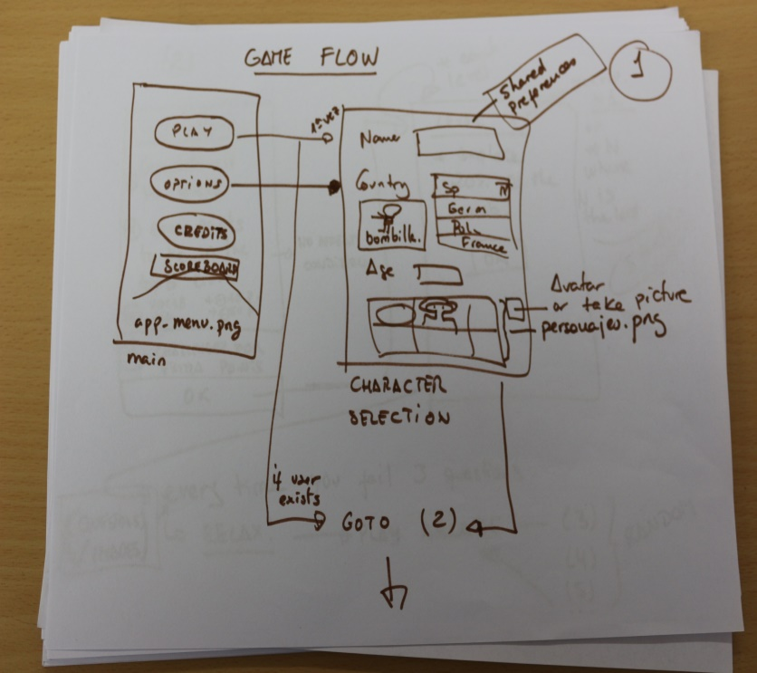
Workshops

Slide 11
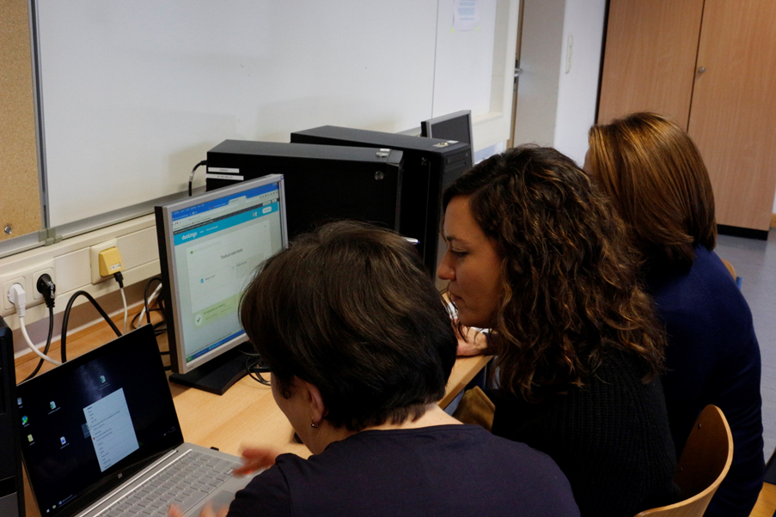
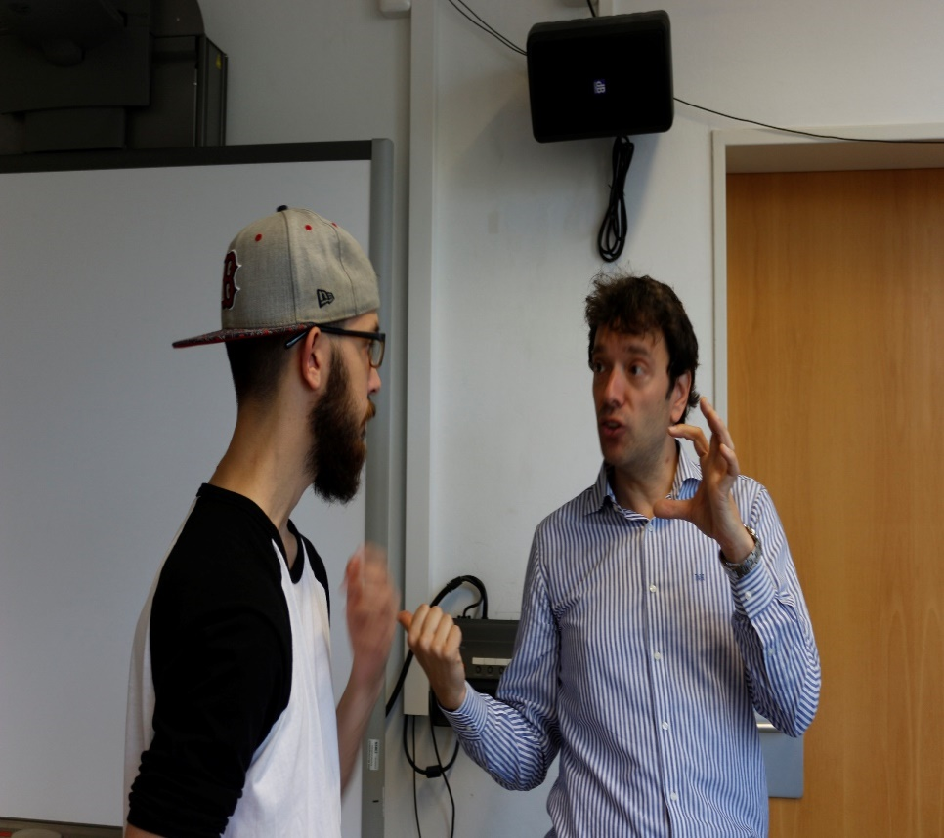
…working…

Slide 12
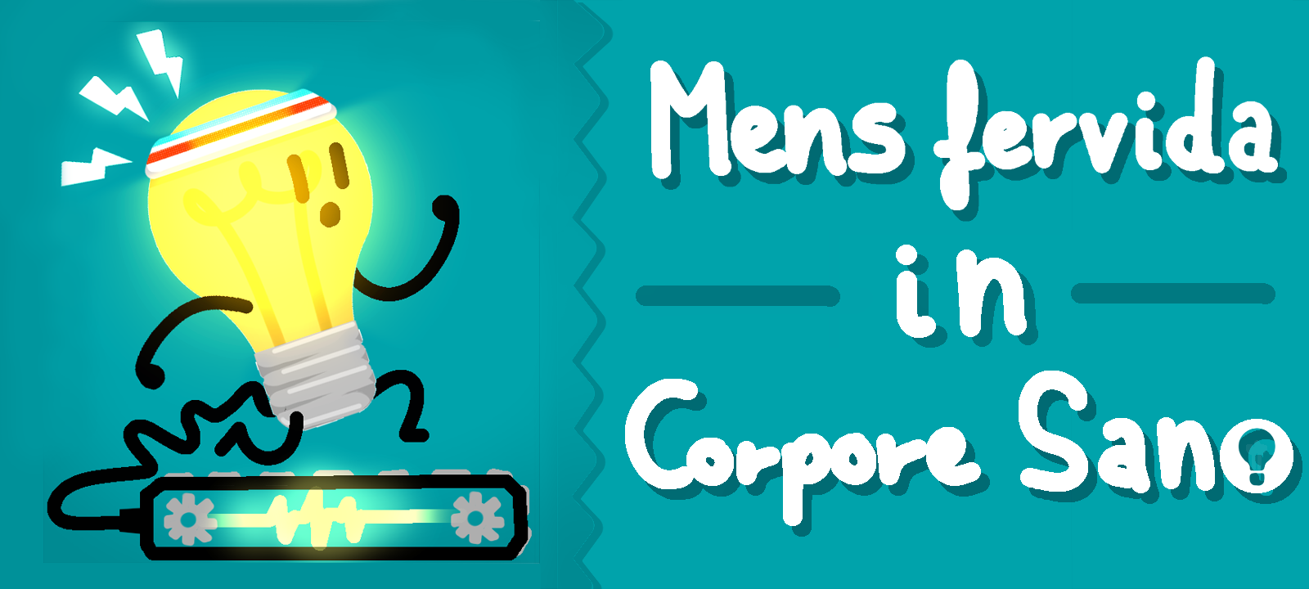
WORK DONE SO FAR….
Some images, logos, etc

Slide 13
CHARACTER SELECTION

Slide 14
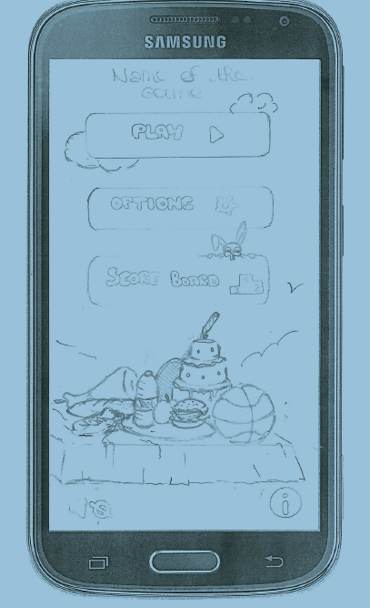
MAIN SCREEN

Slide 15
Some food arcade

Slide 16
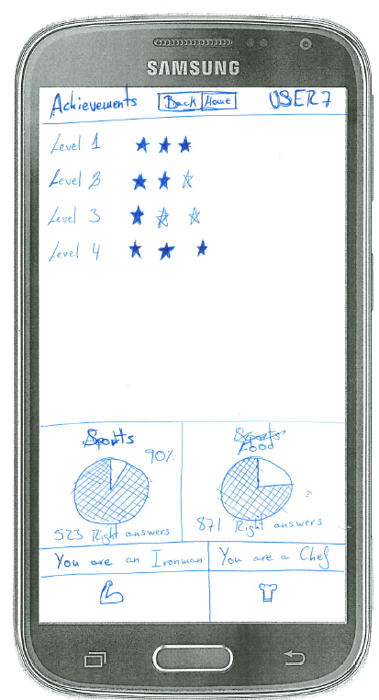
Top scores / Achivements

Slide 17
Questions / Images screens

Slide 18
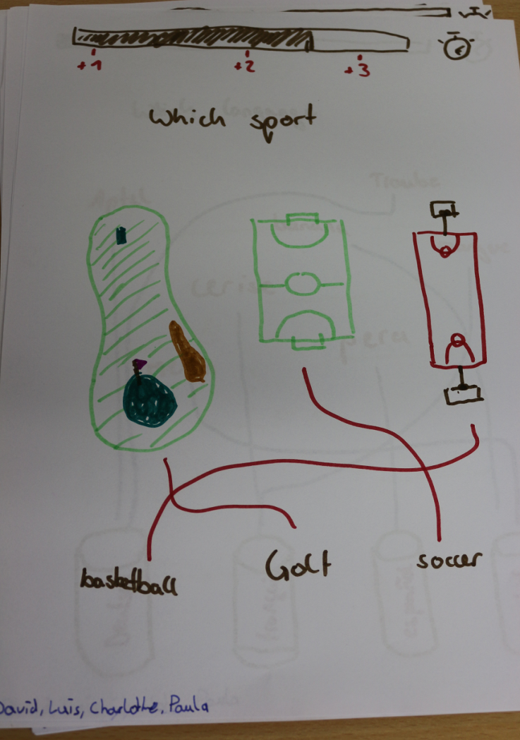
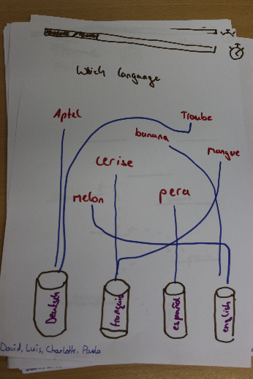
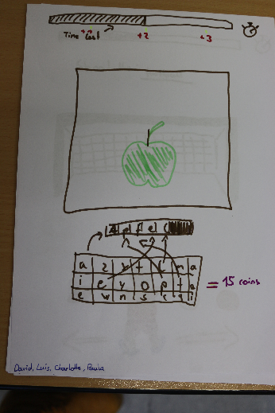
We collected some ideas for the arcade part of the game

Slide 19
Summary
Flow and logic decided
Map of screens designed
Some arcades to be programmed
Vocabulary spreadsheets ready to be filled in
Please send them next week so we can start programming

